Slide 1


str
immutable sequences of Unicode codepoints

Slide 2
String Literals
‘This is a string’ “This is also a string”

Slide 3
Strings with Newlines
Multiline strings
Escape sequences

Slide 4



‘\r\n’
carriage-return newline
‘\n’
newline

Slide 5



Universal Newlines
‘\n’
PEP 278
http://www.python.org/dev/peps/pep-0278/

Slide 6
Escape Sequences
Sequence | Meaning
\newline | Backslash and newline ignored
\\ | Backslash (\)
\’ | Single quote (‘)
\a | ASCII Bell (BEL)
\b | ASCII Backspace (BS)
\f | ASCII Formfeed (FF)
\n | ASCII Linefeed (LF)
\r | ASCII Carriage Return (CR)
\t | ASCII Horizontal Tab (TAB)
\v | ASCII Vertical Tab (VT)
\ooo | Character with octal value ooo
\xhh | Character with hex value hh
Only recognized in string literals
\N{name} | Character named name in the Unicode database
\uxxxx | Character with 16-bit hex value xxxx
\Uxxxxxxxx | Character with 32-bit hex value xxxxxxxx

Slide 7

Escape Sequences
Sequence
Meaning
\newline
Backslash and newline ignored
\\
Backslash (\)
\’
Single quote (‘)
\a
ASCII Bell (BEL)
\b
ASCII Backspace (BS)
\f
ASCII Formfeed (FF)
\n
ASCII Linefeed (LF)
http://docs.python.org/3/reference/
\r
ASCII Carriage Return (CR)
lexical_analysis.html#strings
\t
ASCII Horizontal Tab (TAB)
\v
ASCII Vertical Tab (VT)
\ooo
Character with octal value ooo
\xhh
Character with hex value hh
Only recognized in string literals
\N{name}
Character named name in the Unicode database
\uxxxx
Character with 16-bit hex value xxxx
\Uxxxxxxxx
Character with 32-bit hex value xxxxxxxx

Slide 8


No Separate Character Type
}
‘a string’
str
‘a ’
No separate character type
"characters" are simply one element strings

Slide 9
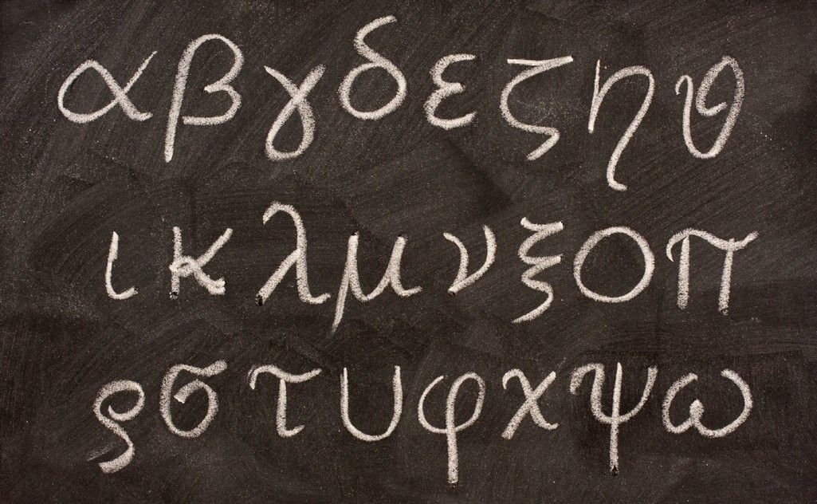


Python Strings Are Unicode
Source encoding: UTF-8
UTF-8 literals

Slide 10

bytes
immutable sequences of bytes

Slide 11
Bytes Literals
b‘data’ b“data”

Slide 12




decode
Converting Between Strings and Bytes
str
bytes
encode
Encodings
http://docs.python.org/3/library/
codecs.html#standard-encodings

Slide 13







Summary: Strings and Bytes
Single- and multi-line string quoting
Adjacent string literal concatenation
Universal newlines
Escape sequences for control characters
Raw strings suppress the escaping mechanism
Convert other types with the str() constructor
Zero-based square-bracket indexing of strings
Rich variety of string methods
Python 3 source encoding is UTF-8
bytes is a sequence of bytes, str is a sequence of Unicode codepoints
bytes literals prefixed with a lowercase b

Slide 14
Summary: Strings and Bytes
Single- and multi-line string quoting
Adjacent string literal concatenation
Universal newlines
Escape sequences for control characters
Raw strings suppress the escaping mechanism
Convert other types with the str() constructor
Zero-based square-bracket indexing of strings
Rich variety of string methods
Python 3 source encoding is UTF-8
bytes is a sequence of bytes, str is a sequence of Unicode codepoints
bytes literals prefixed with a lowercase b
Convert str to bytes with encode(), bytes to str with decode()

Slide 15

Advanced
homogeneous immutable sequence of Unicode codepoints (characters)

Slide 16





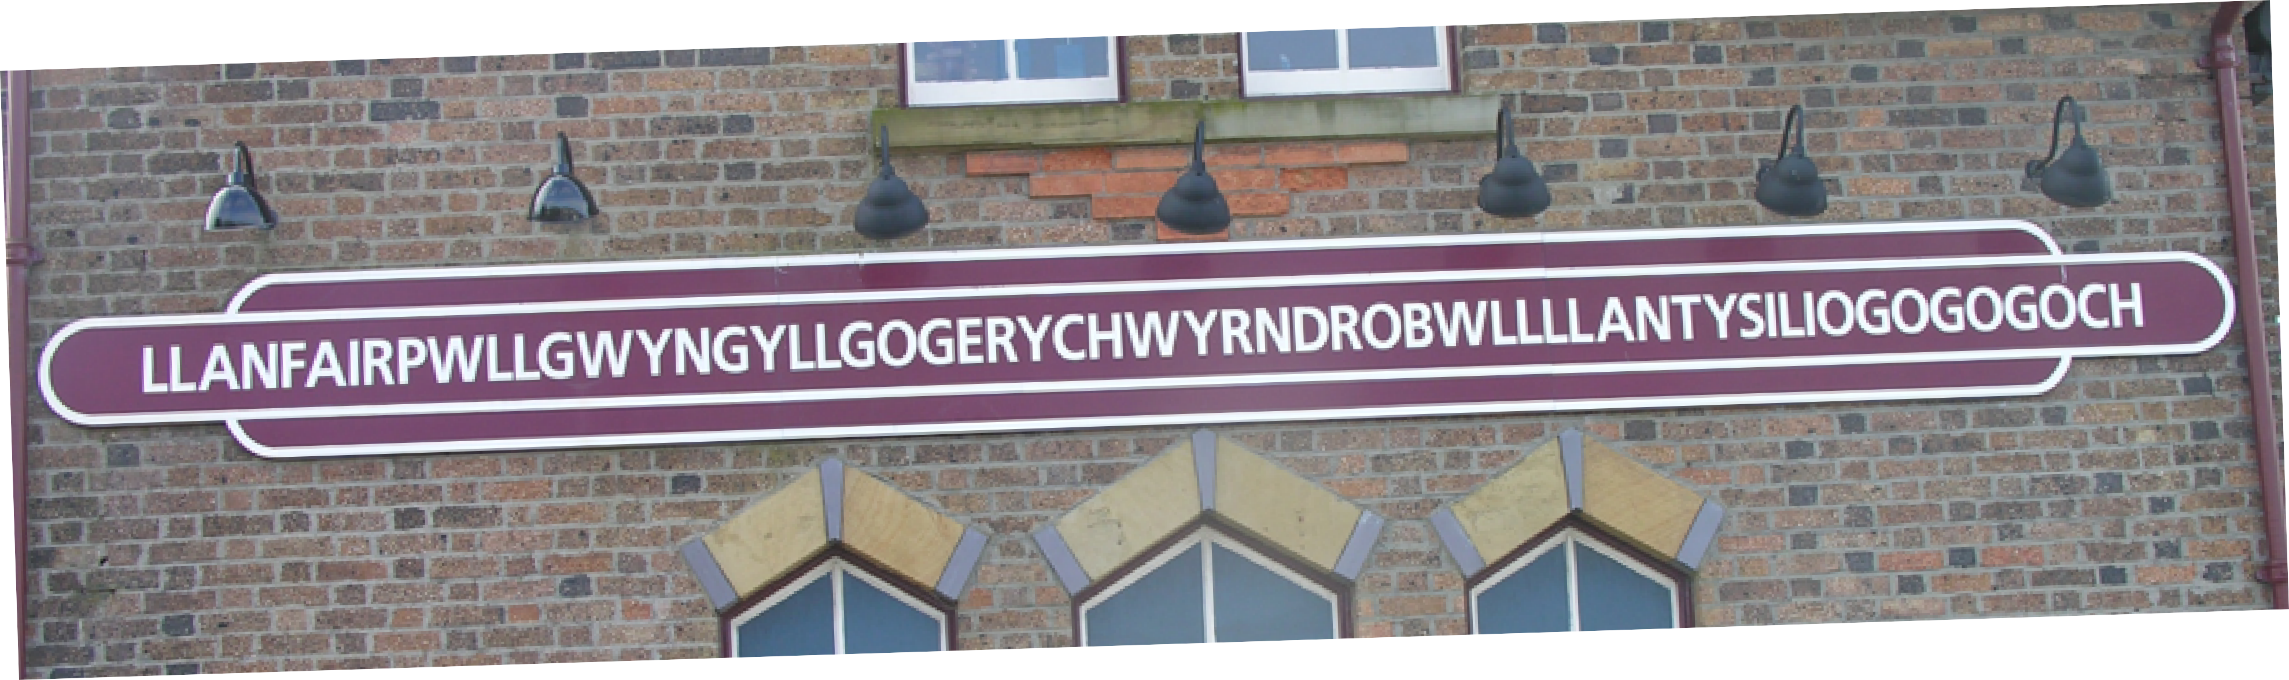
str
•
len(s) gives number of codepoints (characters)

Slide 17




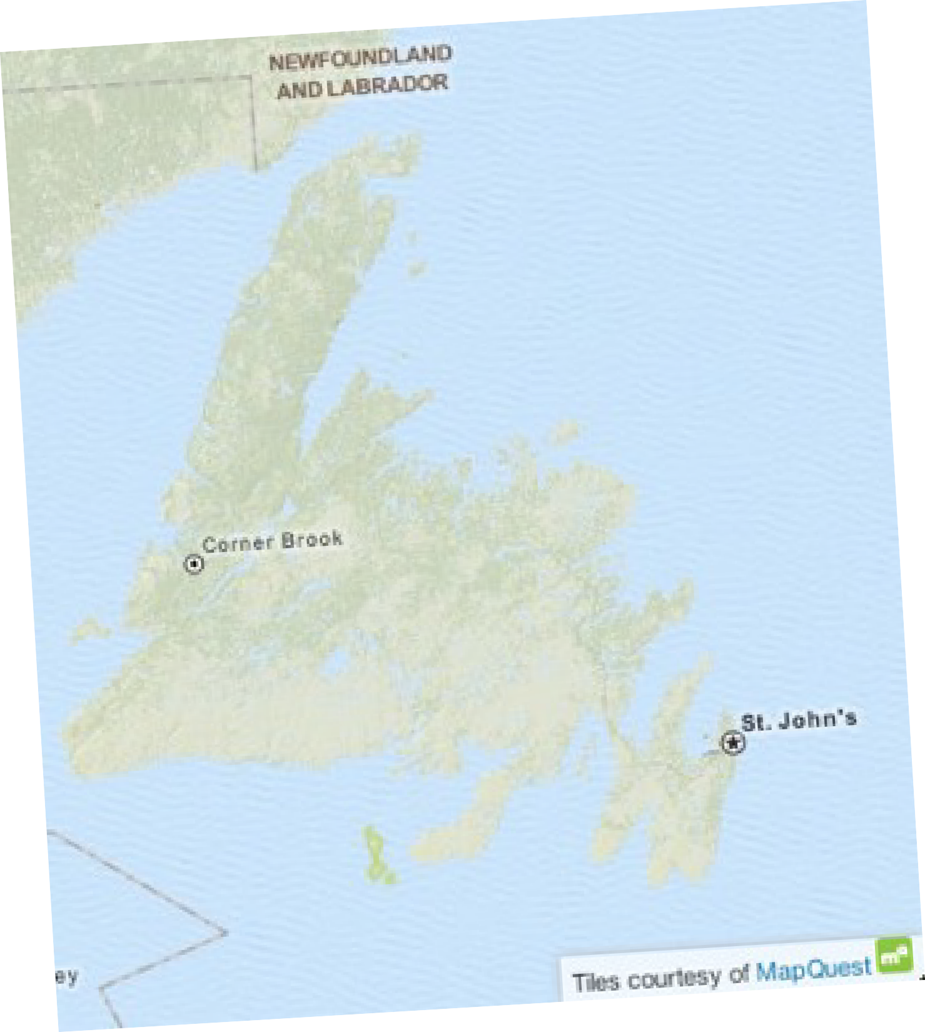
str
•
The + operator can be used for
string concatenation.
•
Strings are immutable, so the +=
operator re-binds the reference
to a new object.
•
Use sparingly – concatenation
with + or += can cause
performance degradation.
Newfoundland

Slide 18




str
•
Call the join() method on the separator string
•
Use split() to divide a string into a list
•
Without an argument, split() divides on
whitespace
•
join()-ing on an empty separator is an important
and fast way of concatenating a collection of strings

Slide 19




str
•
The partition() method divides a string into three
around a separator: prefix, separator, suffix
•
Tuple unpacking is useful to destructure the result
•
Use underscore as a dummy name for the separator
•
Underscore convention understood by many tools

Slide 20



str
•
Use format() to insert values into strings
•
Replacement fields delimited by { and
}
•
Integer field names matched with positional arguments
•
Field names can be omitted if used in sequence
•
Named fields are matched with keyword arguments

Slide 21



str
•
Access values through keys or indexes with
square brackets in the replacement field.
•
Access attributes using dot in the
replacement field.
•
The replacement field mini-language provides
many value and alignment formatting options.

